Slide 1
CMU 10-742 Machine Learning in Healthcare
Lecture 5: Statistics You Need to Know
Adam Berger

Slide 2
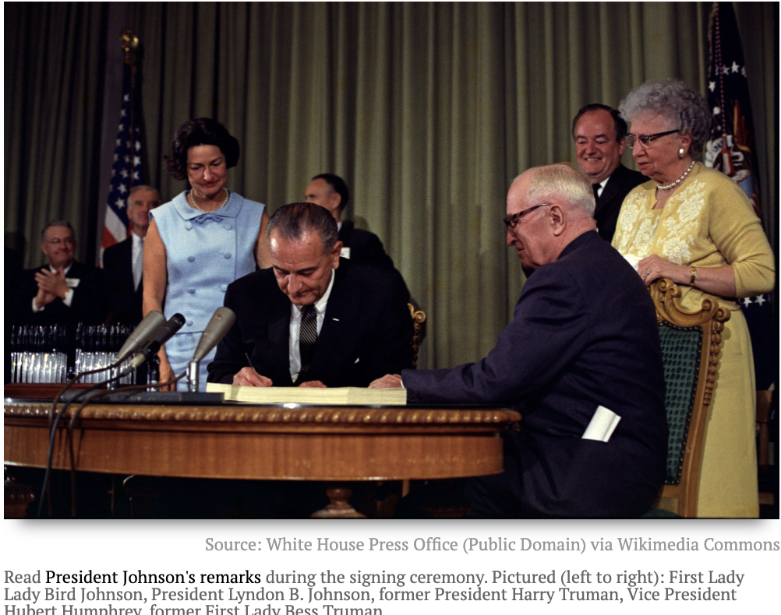
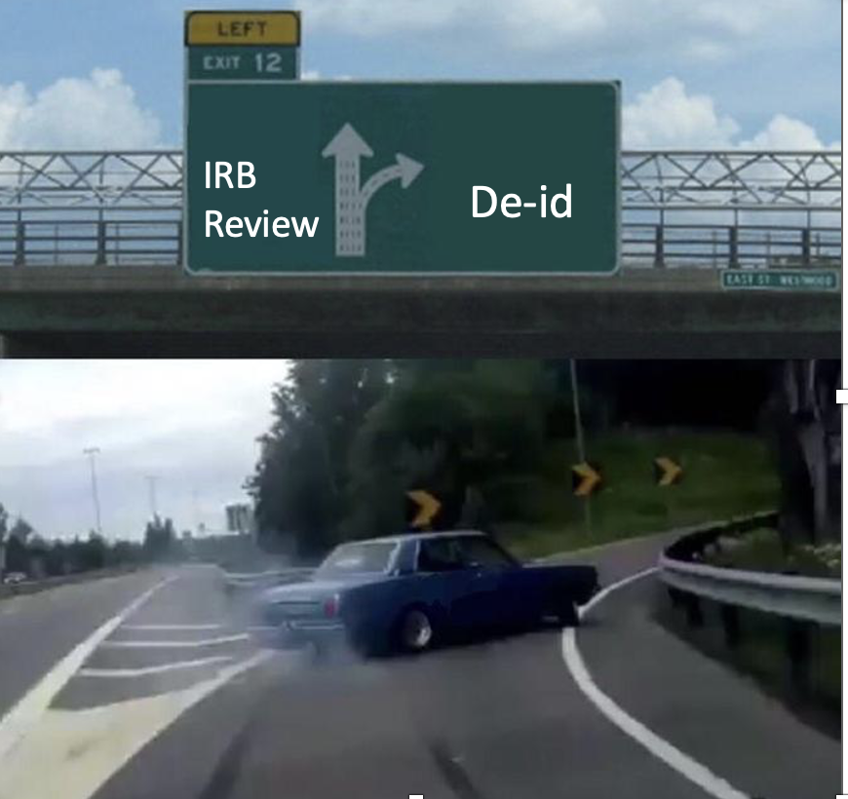
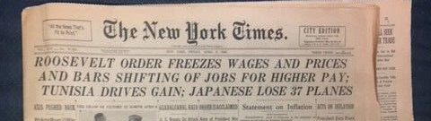
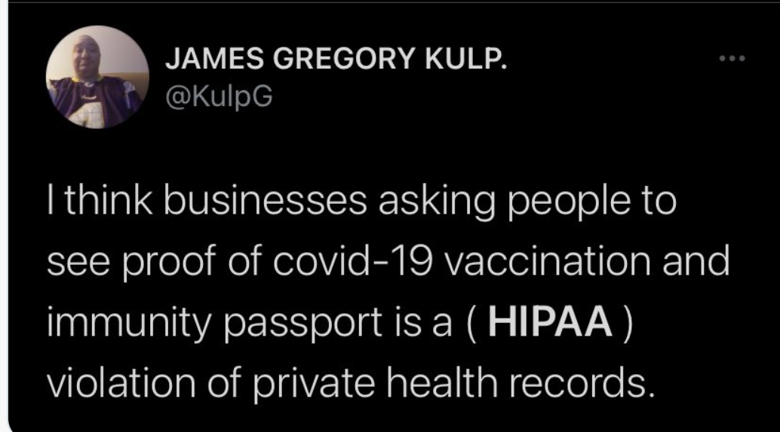
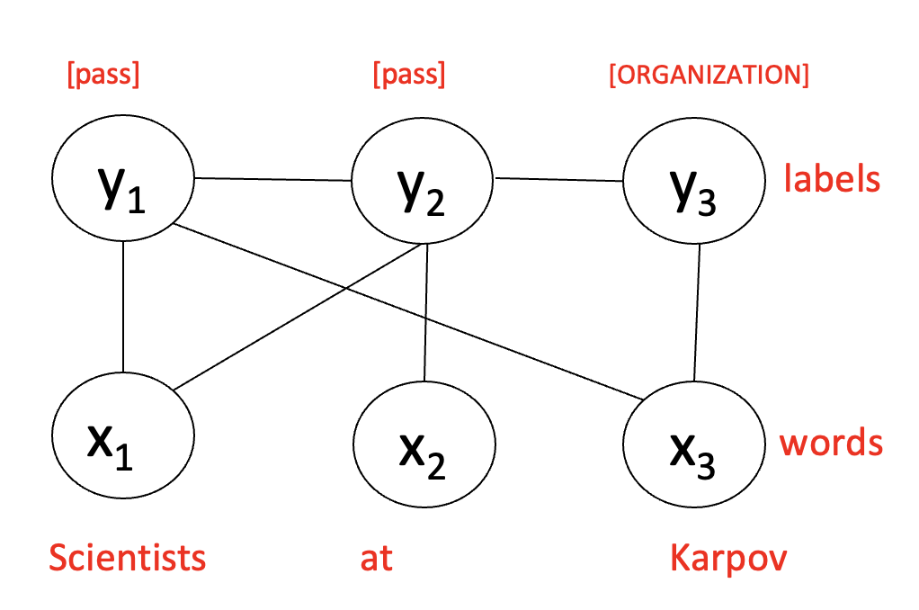
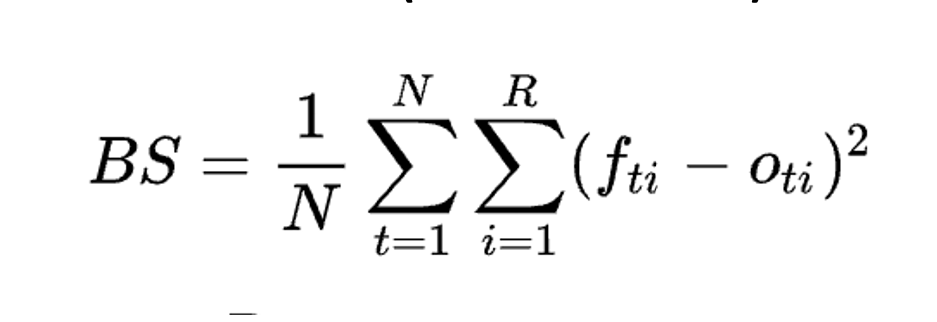
Lecture 4 Recap

Slide 3
Logistics
Assignment 1 due Thursday (Sep 12)
- Part 2 (FHIR) is now a ‘freebie’ but you should do it anyway!
Assignment 2 out Thursday (Sep 12) - requires MIMIC access!
Details on Final project on Canvas
Meme competition due date is now Nov 19

Slide 4
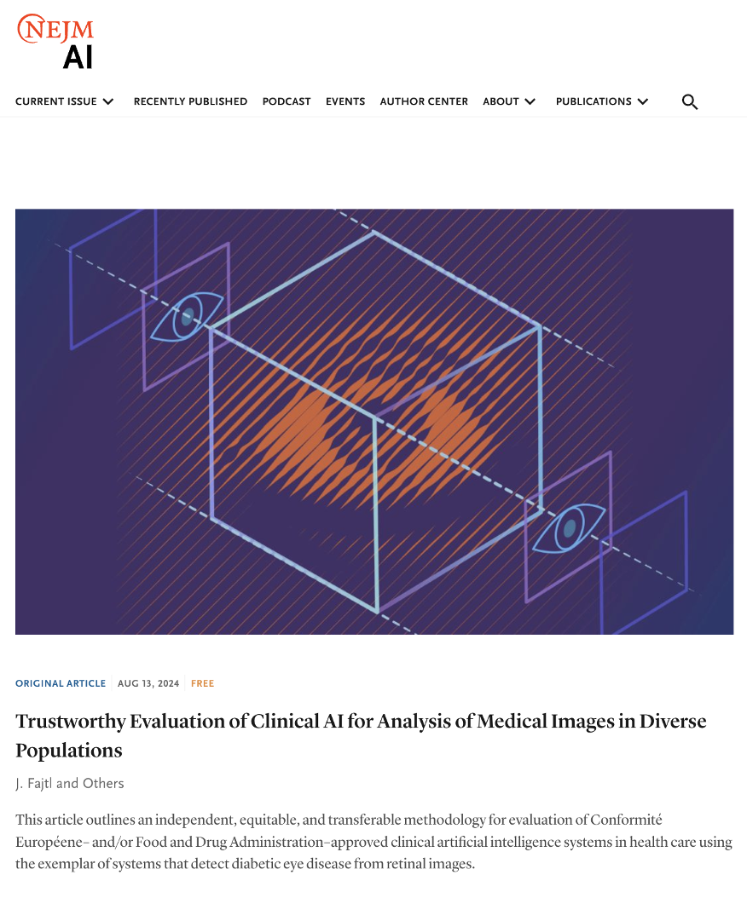

https://ai.nejm.org/

Slide 5


Slide 6
Today
Key probability distributions
Evaluation metrics
Survival modeling
Missing data

Slide 7
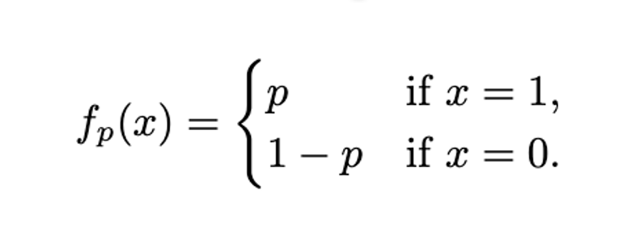
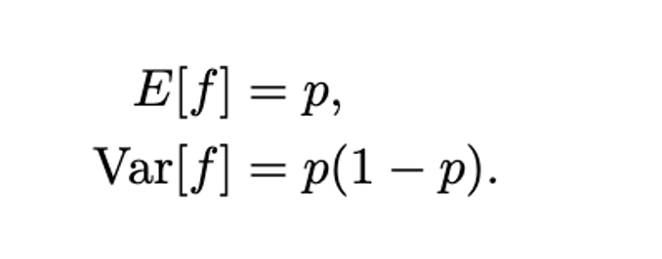
Bernoulli Distribution
Result of a single binary-outcome experiment with success probability p.
Notes:
Examples in healthcare – specifically around medication (rx)?
- Will this patient respond to this rx?
- Will patient patient pick up their rx?
- Will patient adhere to rx?
- Will patient renew rx?
- rx-rx interaction between these two rx?

Slide 8
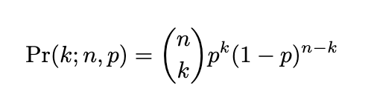
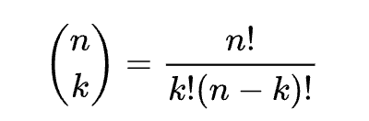
Binomial Distribution
The probability of seeing k successes in n Bernoulli trials:
where
Notes:
(I actually used a colab notebook to walk through much of this)

Slide 9
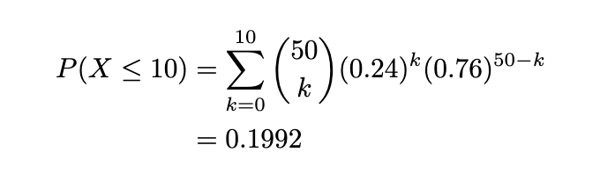
Examples
An antibiotic has p(success) = 0.84. What’s the probability that it works in all 10/10 treated patients?
If the chance of a patient not adhering to their prescription is 0.24, what’s the probability of having 10 or fewer non-adherent patients out of 50?

Slide 10
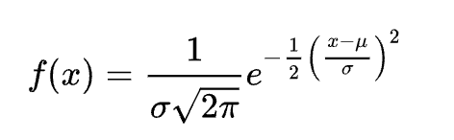
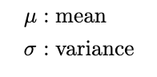
Normal (Gaussian) Distribution
Notes:
Examples in healthcare (specifically around physiological measurements)
- height, weight
not normally distributed:
- BMI - tend to be right skewed
- cholesterol levels - ditto

Slide 11
Central Limit Theorem
The average of a large number of random variables will approximate a normal distribution.
Assumptions:
Variables are independent and identically distributed (i.i.d.)
Variables have finite mean & variance
You take enough samples (N>30 typically)

Slide 12

Notes:
CLT is important in healthcare for 2 related reasons:
Can sidestep density estimation altogether (e.g. BMI - right skewed, who knows the shape?)
Many statistical tests in healthcare research assume normality. (e.g. Pearson correlation coefficient between two vars: r = Σ(x - x̄)(y - ȳ) / √[Σ(x - x̄)²Σ(y - ȳ)²] ). Can apply these tests to the sum/mean even if you don’t know the distribution

Slide 13
Which are valid applications of the CLT?
Average blood pressure in Medicare population
The number of new influenza cases per day during an outbreak in Portland, Maine
Average length of stay for patients at AHN admitted for suspected MI
A study on cancer recurrence from a new therapy for a rare form of childhood leukemia (affects 1 in 1M children)
Notes:
Yes
No – not indepedent events
Yes
No – probably << 30 patients

Slide 14
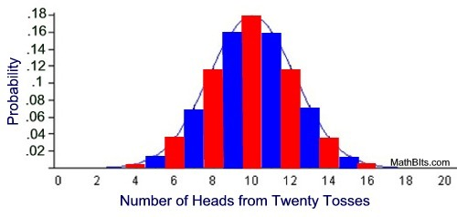
Brothers from Another Mother
Binomial is discrete and has support only for positive integers.
Normal is continuous and has support for all real values.
But for n large enough and p not too close to 0 or 1, they look very similar…
Notes:
Q: why is binomial ~ normal with large enough n? (CLT): Binomial distribution is just the sum of n independent Bernoulli trials.)
CLT says: as n increases, the avg (and sum) of these trials approaches normal distribution
Assumption: np > 5 and n(1-p)>5 (need enough successes and failures!)

Slide 15
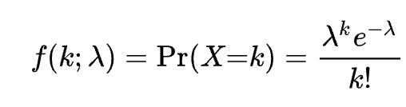
Poisson Distribution
A process occurs λ times per minute.
The events occur independently of one another.
The probability that this process will generate k events in a minute is:
Notes:
E.g. # of patients arriving at an ER
Not really poisson, since lambda is different every hour.

Slide 16
Examples
On average, 5 patients arrive at the ER per hour. What’s the chance that 10 patients will arrive in a single hour? What’s the chance no patients will arrive?
On average, 2 people out of 100K develop ALS every year. What’s the chance than in Pittsburgh, no one will be diagnosed with ALS in 2025?

Slide 17
Today
Key probability distributions
Evaluation metrics
Survival modeling
Missing data

Slide 18
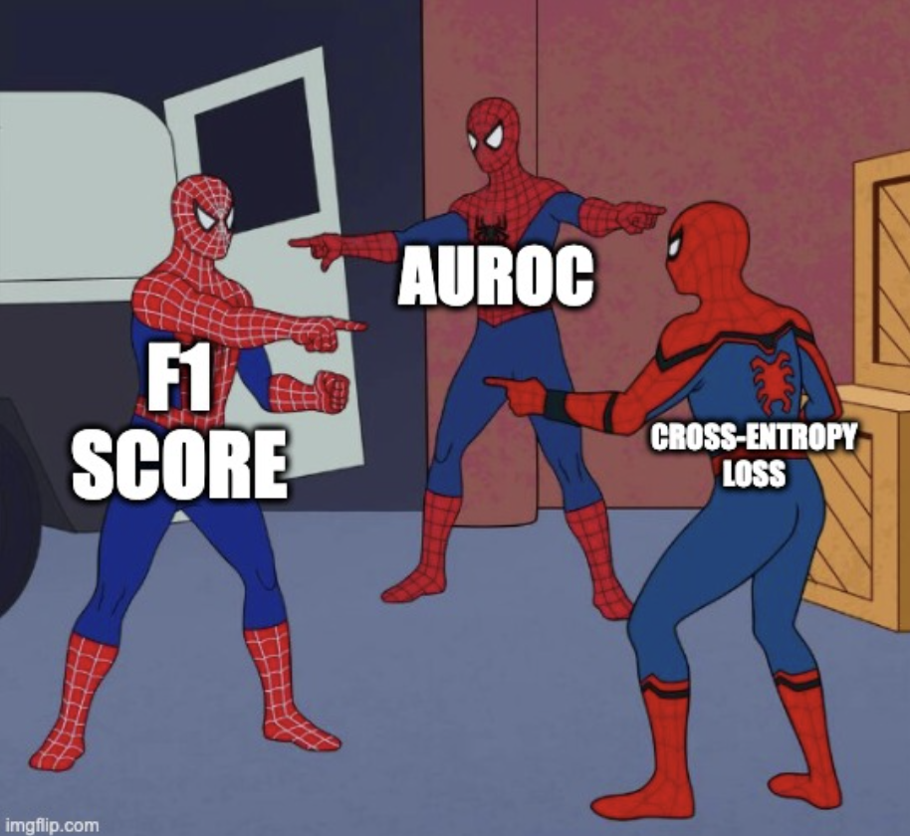

Slide 19
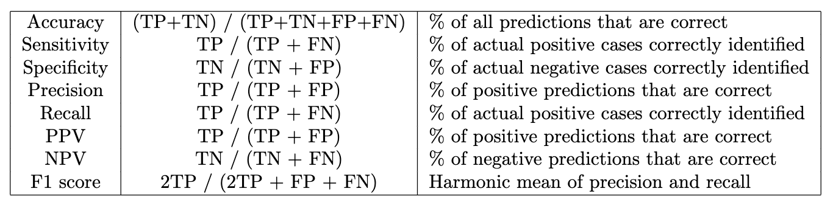
Metrics for Binary Classification
Notes:
Just for binary classification here

Slide 20
Metrics for Binary Classification
Notes:
Just for binary classification here

Slide 21
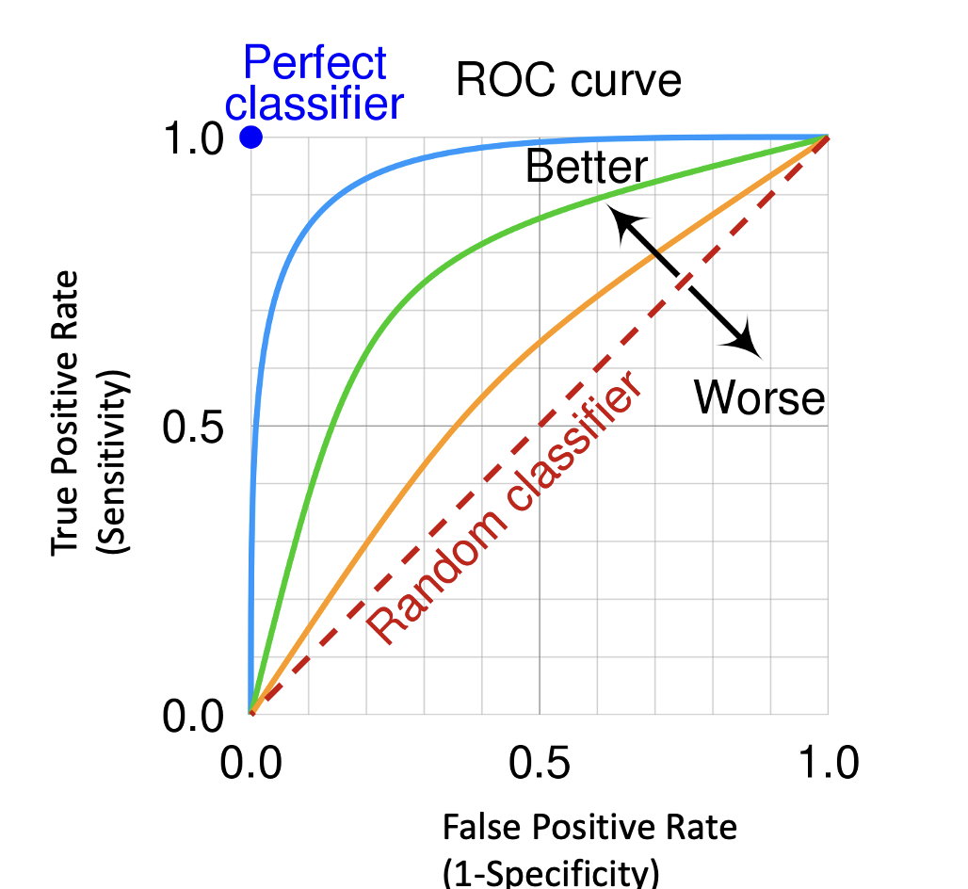
ROC Curves
AUROC: area under the curve (0.5 – 1.0)
Notes:
Imagine an ML algorithm to predict whether you will get diabetes
Q: What is the classifer that lives at (0,0)? Everything neg (1,1)? Everything pos.
In between: tune the classifier
Can you be under the diagonal line? (If so, just do the opposite of the classifier)

Slide 22
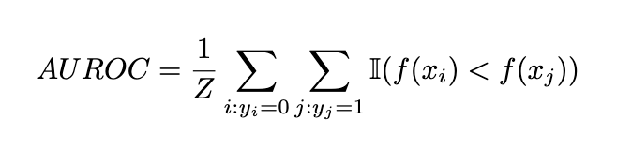
Another interpretation of AUROC
“Probability that a randomly chosen positive instance is ranked higher than a randomly chosen negative instance.”
Notes:
What is this saying?
For all pairs a,b where a=0 and b=1. how often does the model rank b above a?
Intuition: unlike MSE, AUROC doesn’t depend on actual computed probabilities.
In fact, it’s completely independent of threshold you end up picking (unlike recall, precision, etc.)

Slide 23
What’s a shortcoming of ROC curves?
Notes:
Imagine we’re performing risk-stratification – trying to find the very severe cases.
Say there’s only 10 severe cases out of 1000. We want a classifier that assigns these 10 a very high score.
Which part of the curve is most important for us?

Slide 24
2 Shortcomings of ROC Curves
This is the critical region for risk stratification
FPR = FP / (FP + TN)
Notes:
1. For risk-strat, we disproportionately care about red area
2. Consider a highly imbalanced data set. Only 10 positives among 1,000 samples.
classifier A: ranks the positives in the top 20
classifier B: ranks the positives in the top 100 (many more false positives)
A>>B, but ROC doesn’t reflect that – it uses TN in denominator, which overwhelms the statistic. FPR = FP / (FP+TN)

Slide 25
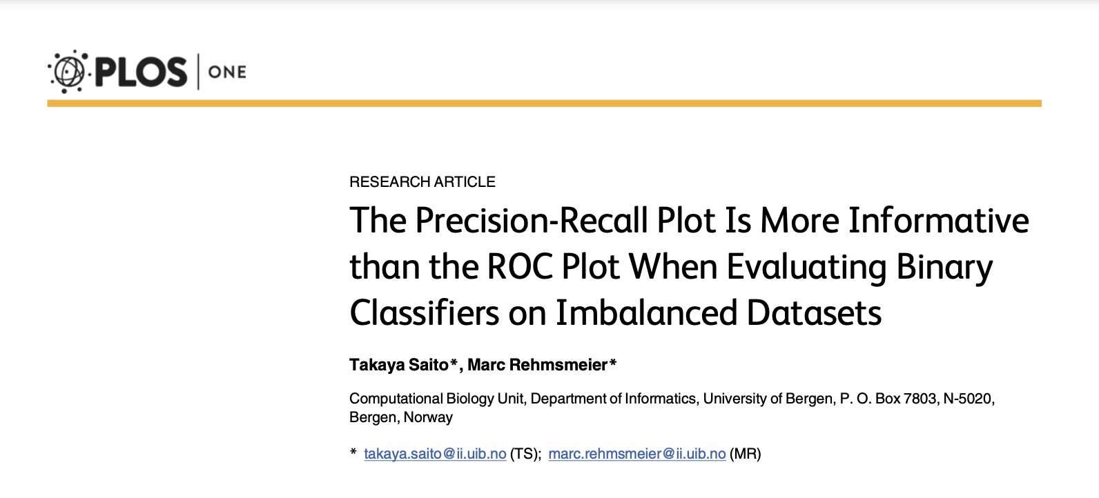
https://journals.plos.org/plosone/article/file?id=10.1371/journal.pone.0118432
Notes:
Surprisingly controversial subject even today

Slide 26
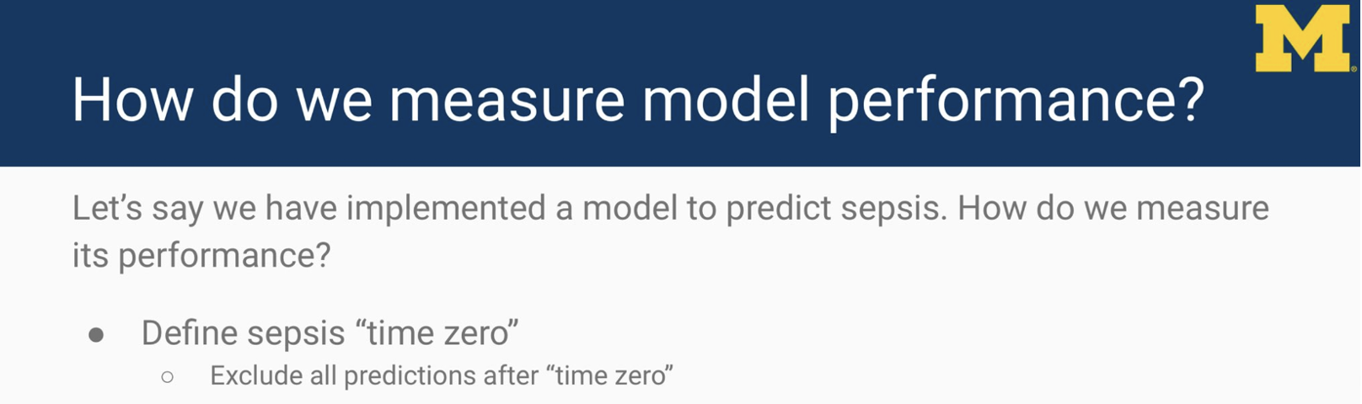
https://x.com/kdpsinghlab/status/1377593699207634945/photo/1
Notes:
Even just saying “We measured the AUC of the model” can be ambiguous.
Q: You have a system that predicts whether the patient will get sepsis. It generates a score every hour. How might you eval this model?
Highest prediction
All predictions
Time to event

Slide 27
Halftime

Slide 28
Today
Key probability distributions
Evaluation metrics
Survival modeling
Missing data
Notes:
healthcare ML are often classification problems – is this patient going to get this disease?
But here’s an important non-classification problem: how long is this group of patients going to live?

Slide 29

Dr. Stalk has a new therapy for lung cancer.
She recruits 1000 patients and monitors them over the next 2 years. She also tracks 1000 patients in a control group.
How can we assess her new therapy?
This section loosely adapted from:
https://ocw.mit.edu/courses/6-s897-machine-learning-for-healthcare-spring-2019/resources/lecture-6-physiological-time-series/
Notes:
How about “# patients alive at the end?”
No: Consider 2 trials, there’s 50% surviving at the end of the trial. But in trial #1, all 50% died in the first month; in trial #2, all 50% died in the final month of the trial.
No: what about people who disappear during the trial?
How about "# of patients who die each month?"
No: what about patients who disappear during the trial?

Slide 30
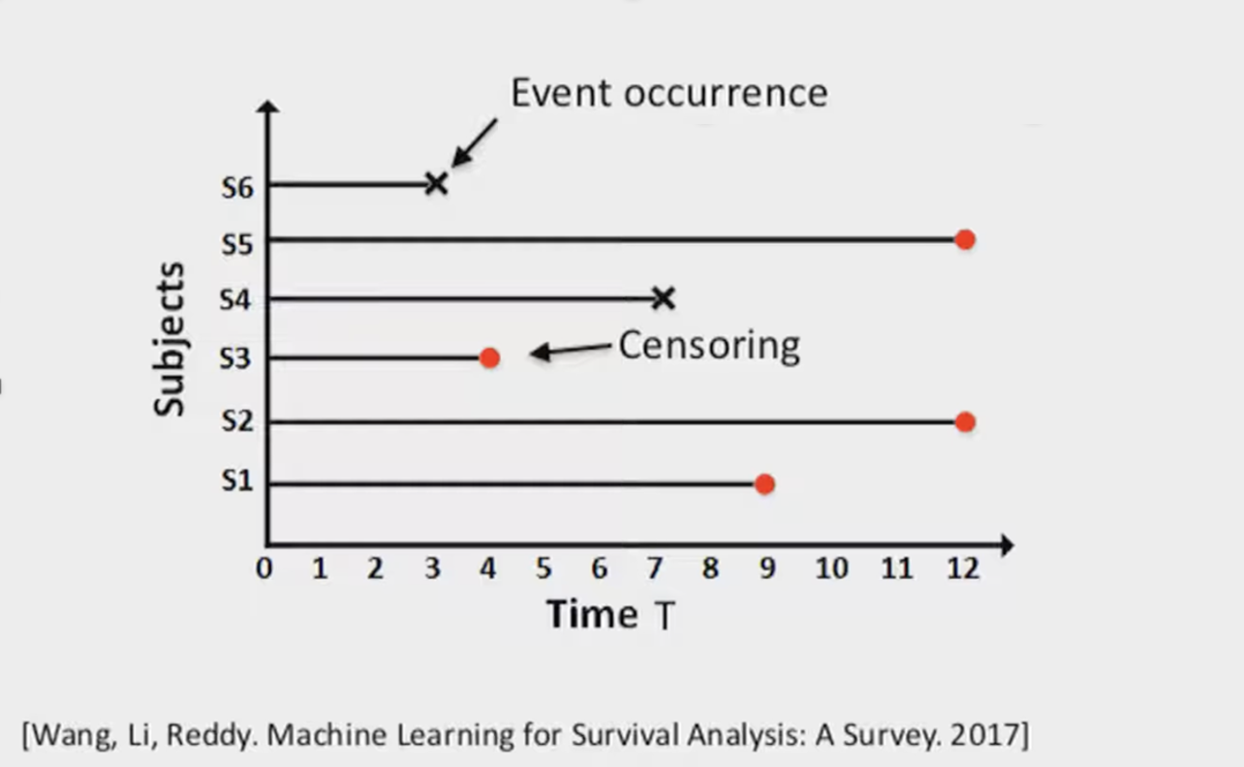
Notes:
X = patient died
Red: censored data. Either trial ended and patient still alive (S2, S5), or patient disappeared (S1, S3)
.

Slide 31
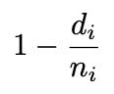
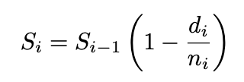
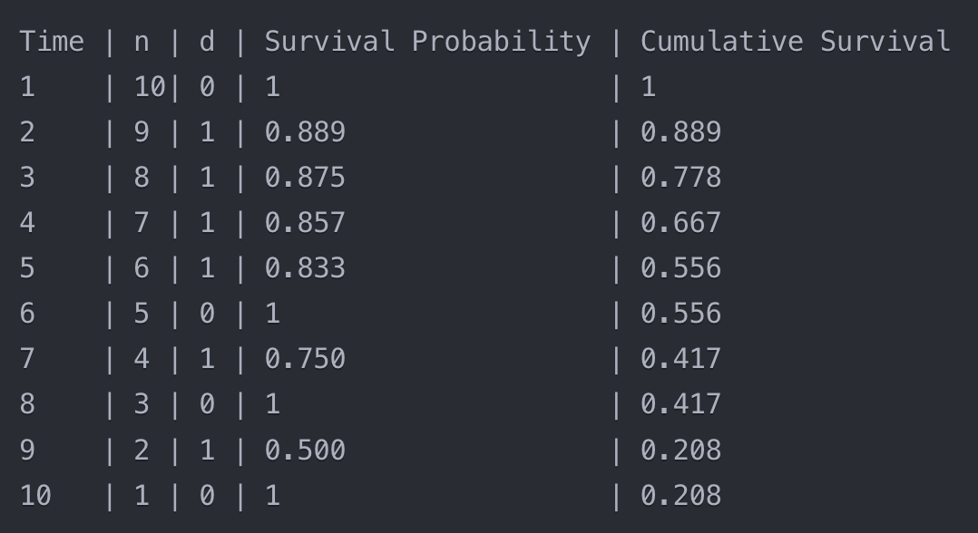
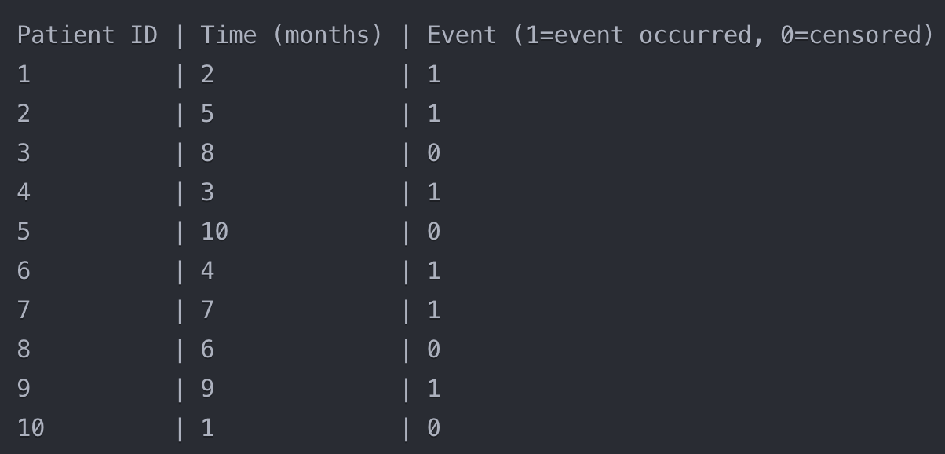
Let’s Build a Kaplan Meier Curve
Notes:
(Do interactively)
n = # entering this time period
d = # died during this time period
Helpful – the python ‘lifelines’ package.
nothing fancy going on here, this is just fitting a line to the observed data.

Slide 32
Let’s Build a Kaplan Meier Curve
Notes:
n = # entering this time period
d = # died during this time period
Helpful – the python ‘lifelines’ package.
nothing fancy going on here, this is just fitting a line to the observed data.

Slide 33
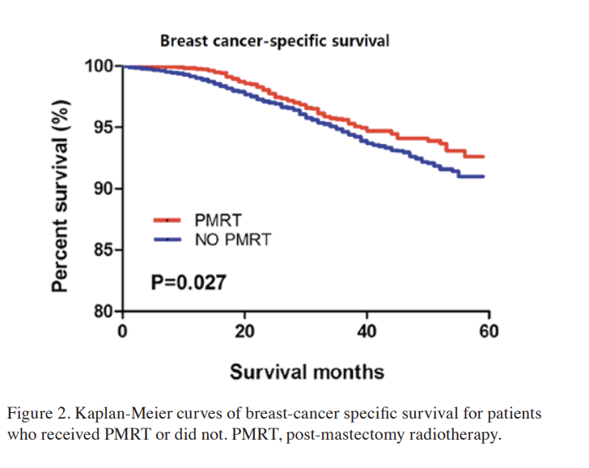
Kaplan Meier Curves
https://www.researchgate.net/publication/337434530_T1-2N1M0_triple-negative_breast_cancer_patients_from_the_SEER_database_showed_potential_benefit_from_post-mastectomy_radiotherapy/link/5dd734efa6fdcc474feb74c9/download?_tp=eyJjb250ZXh0Ijp7ImZpcnN0UGFnZSI
Notes:
What would a very effective therapy look like? A terrible one?
Kaplan-Meier curve is a non-parametric estimator (What does that mean?)

Slide 34
Shortcomings of Kaplan-Meier
Can’t easily handle covariates
Assumes censoring is non-informative.
Non-parametric – can’t extrapolate outside the support

Slide 35
Advanced approaches to survival modeling
Cox Proportional Hazards Model
Parametric models
Random Survival Forests
NN-based models
Notes:
Cox: more complex than Kaplan Meier. Can handle covariates.
Parametric – see next. (“opiniated”)

Slide 36
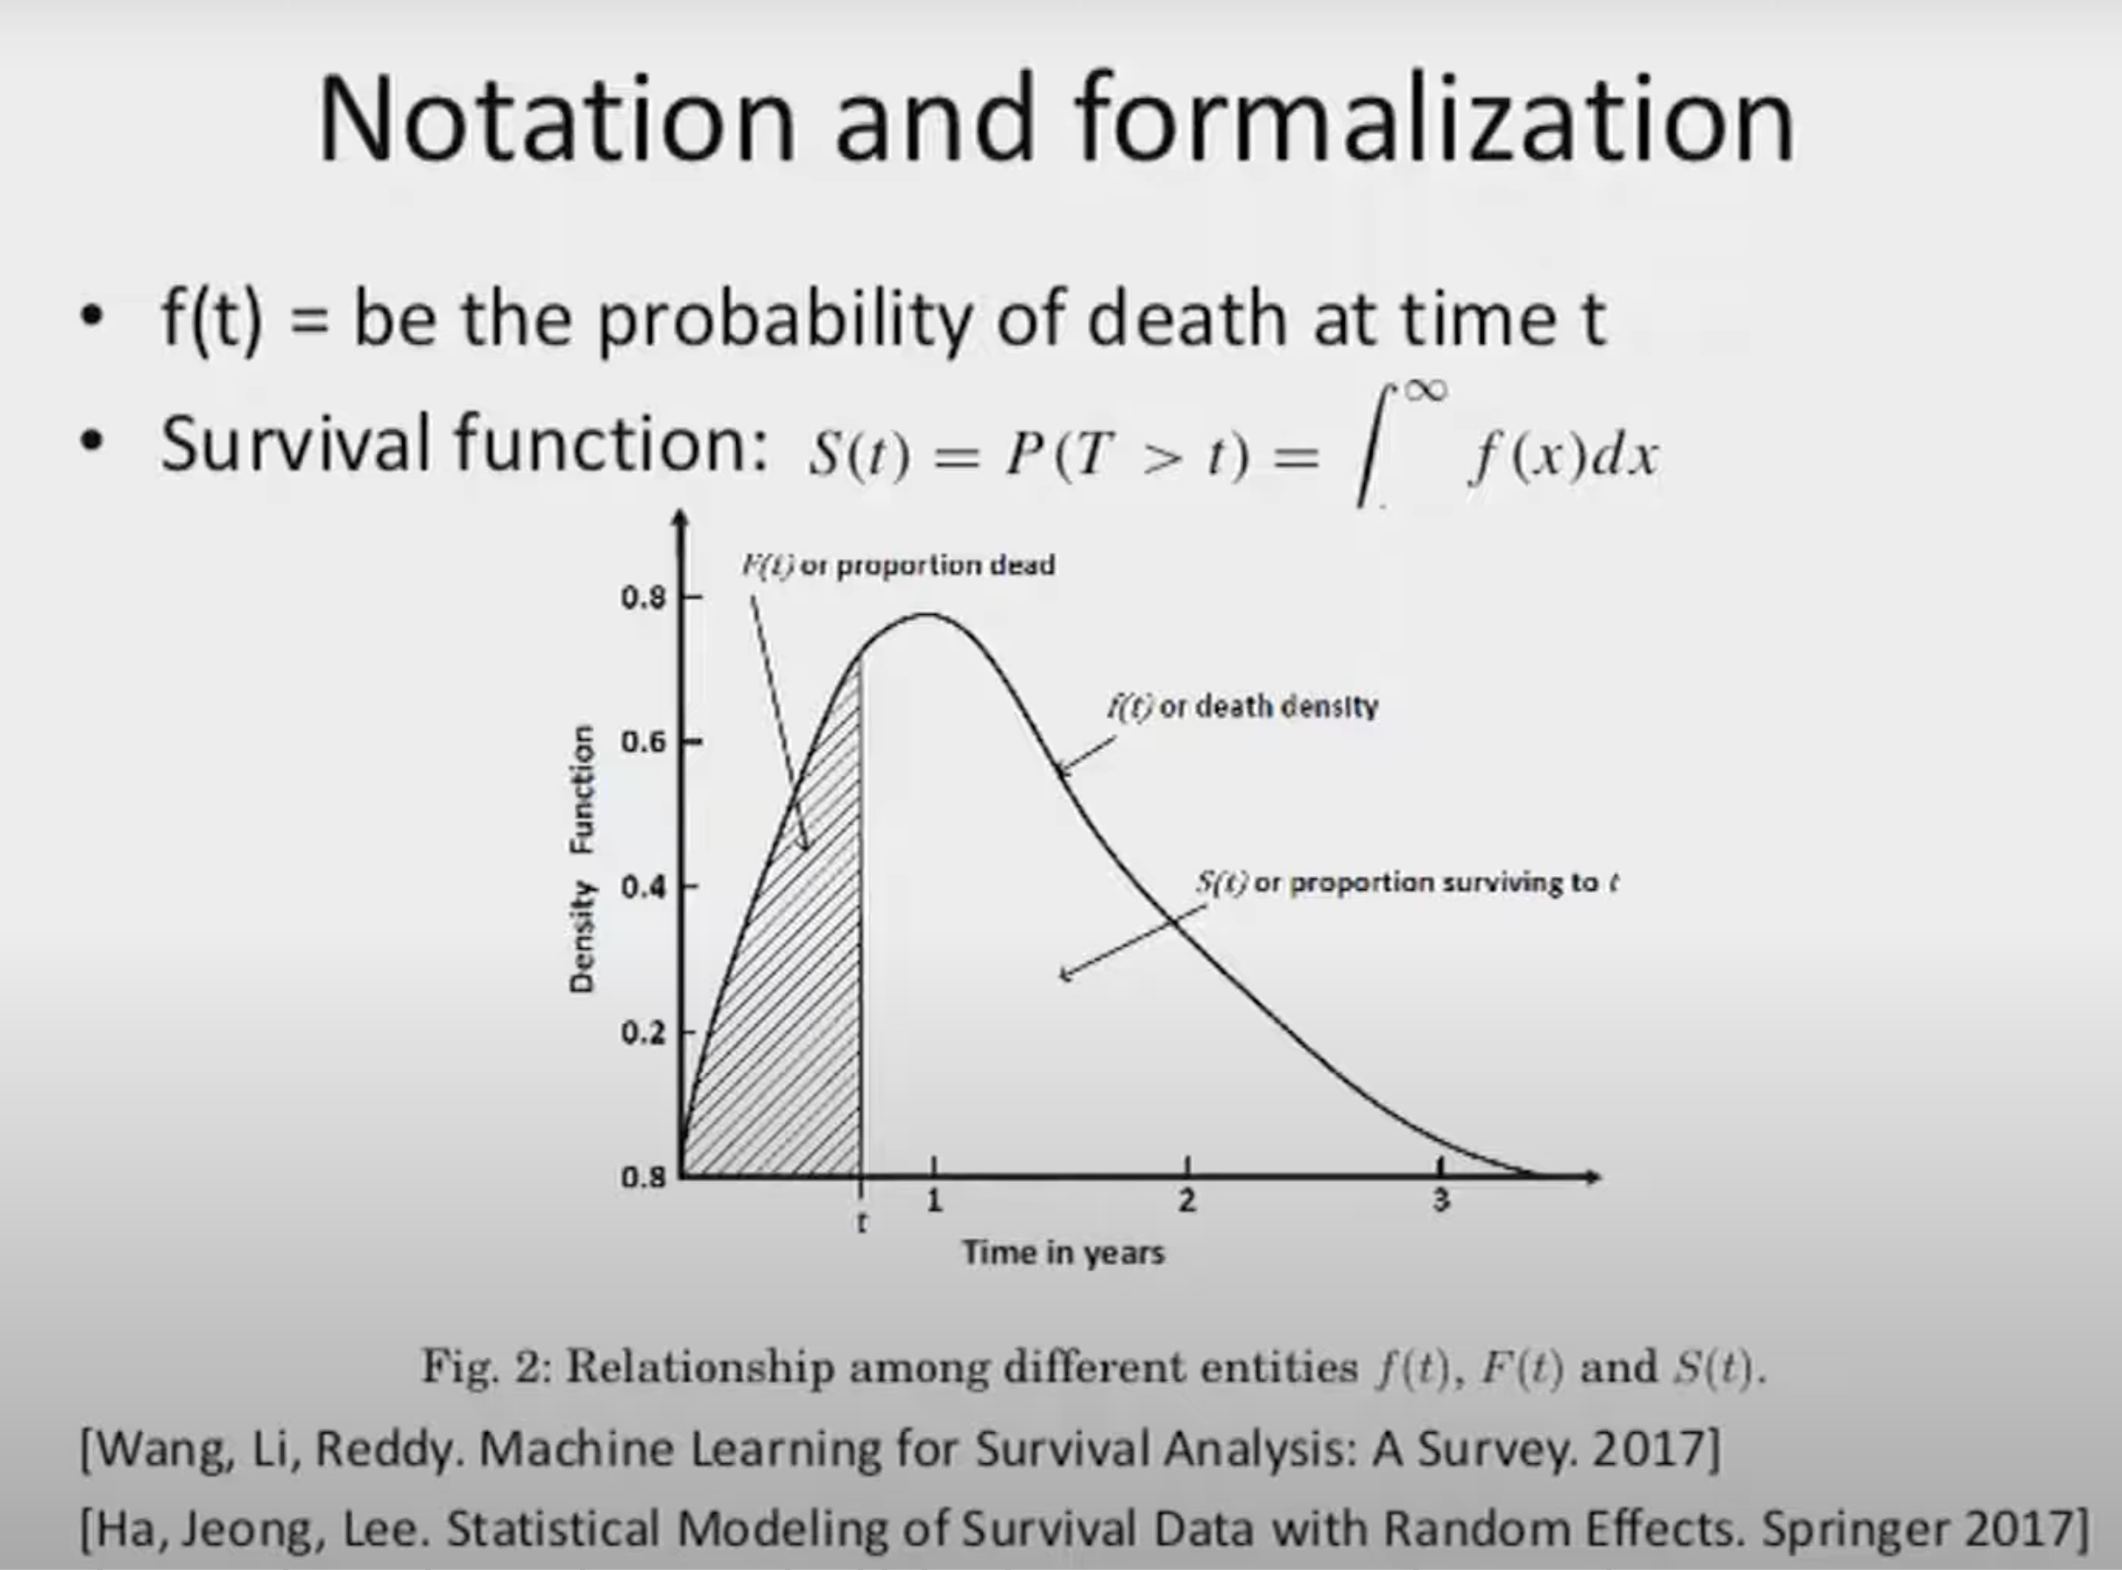
Notes:
Paramterric modeling - let’s formalize this with some notation
(Slides from Szolovitz/Sontag)

Slide 37
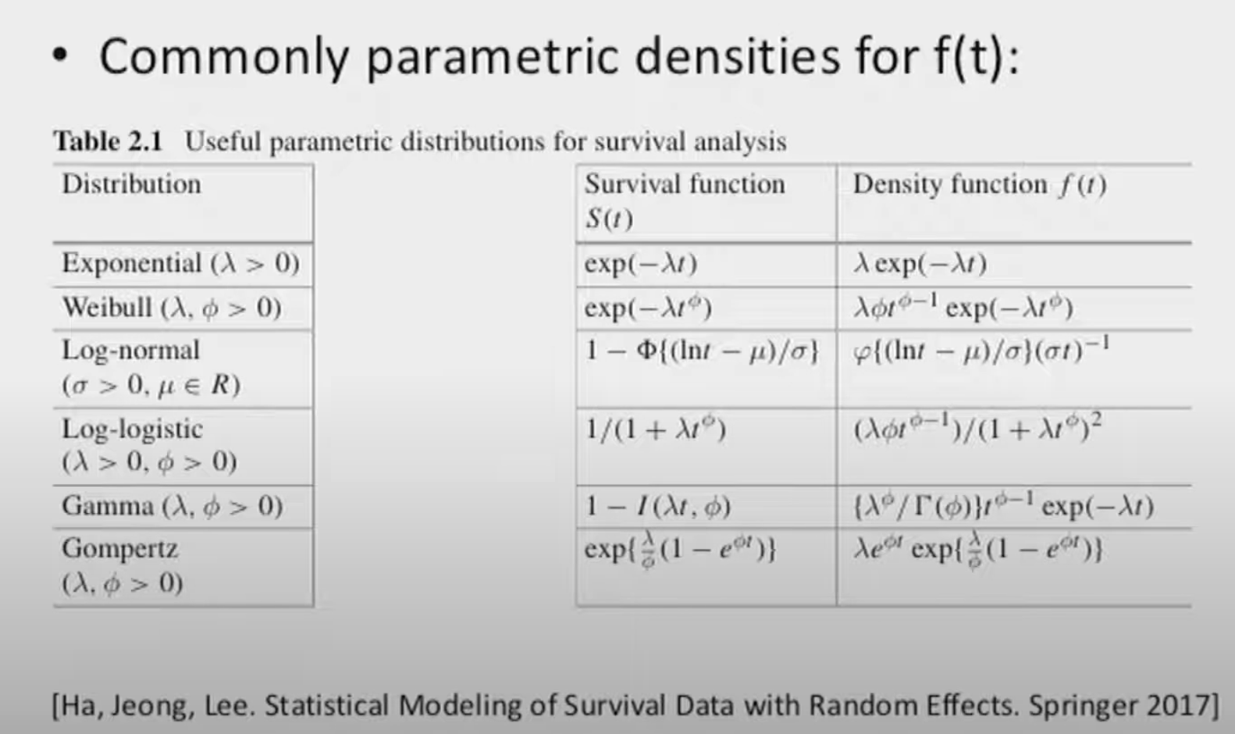
Notes:
Idea: Given a KM curve, build a model for S(t) (or f(t))
f(t): "probability of death. at time t"
S(t) = 1- cumulative density function = integrate f(t) from t to infinity
these are some common paramtric functions for survival curves

Slide 38
Advanced approaches to survival modeling
Cox Proportional Hazards Model
Parametric models
Random Survival Forests
NN-based models
Notes:
Ensemble method, builds trees iteratively like RF does, to maximize likelihood of observed survival data.. Less interpretable than KM.
GOOD FOR FINAL PROJECT

Slide 39
Random Survival Forests
Train:
Build n survival trees in standard greedy recursive manner
Each tree has a pdf at the leaf
Build each on a different bootstrap sample of training data
At each tree node, only evaluate split criterion for a randomly selected subset of features and thresholds.
Inference:
Aggregate predictions of individual trees in the ensemble.
https://link.springer.com/article/10.1007/s10994-021-06117-0
Notes:
Spit criterion – typically use log-rank statistic (any criteria that produces the largest difference in survival distributions at the two child nodes)

Slide 40
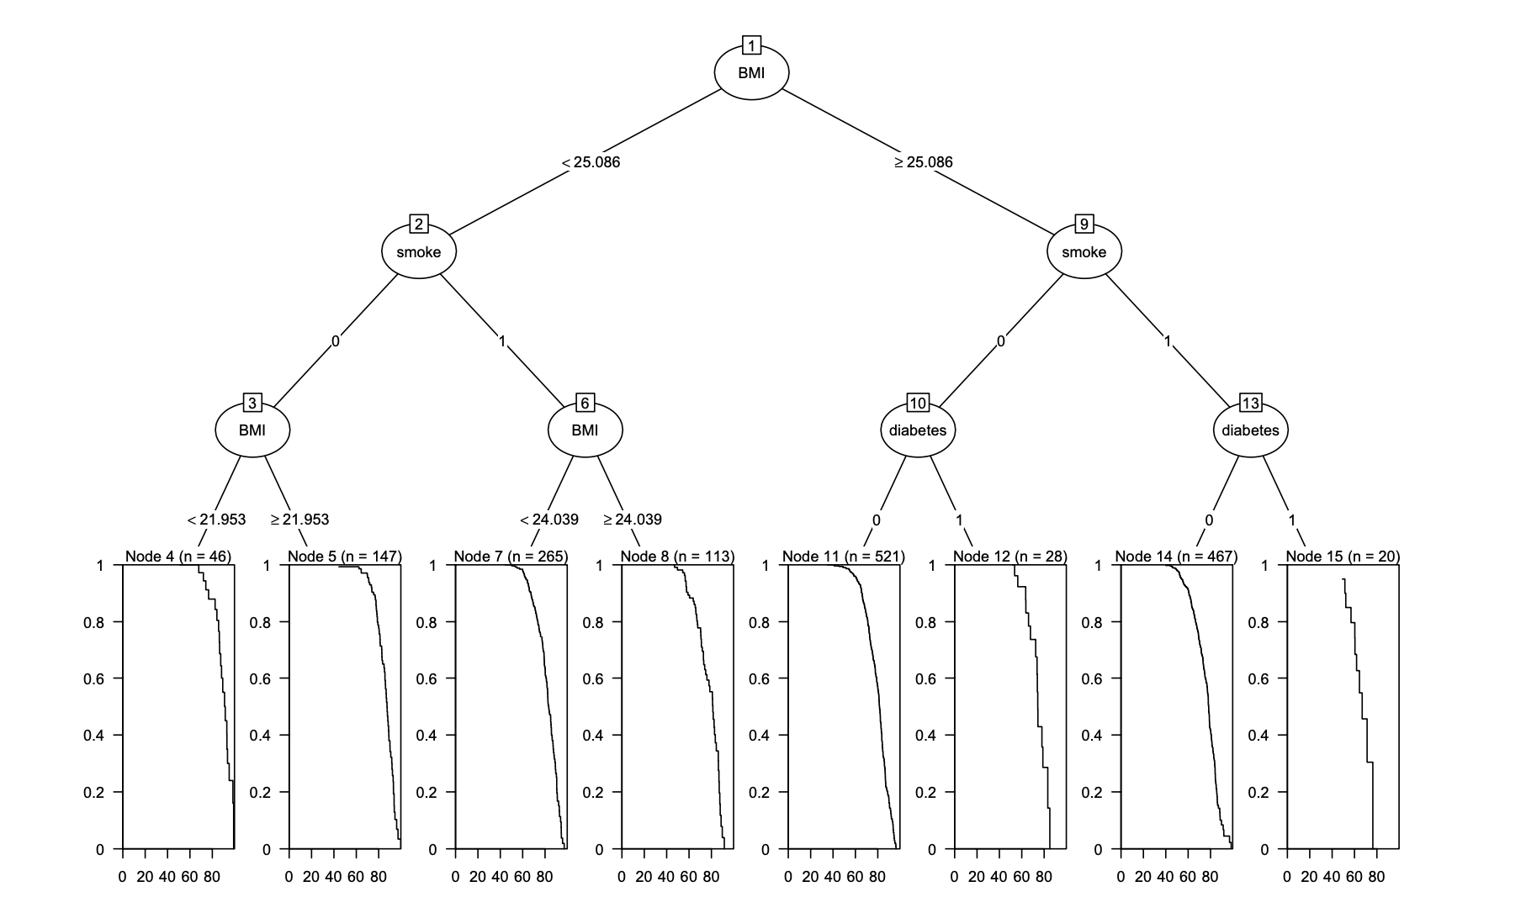
https://link.springer.com/article/10.1007/s10994-021-06117-0
Notes:
Framingham Heart Study dataset
Notice the covariates at each node split
Maximize difference in KM curves at leaves

Slide 41
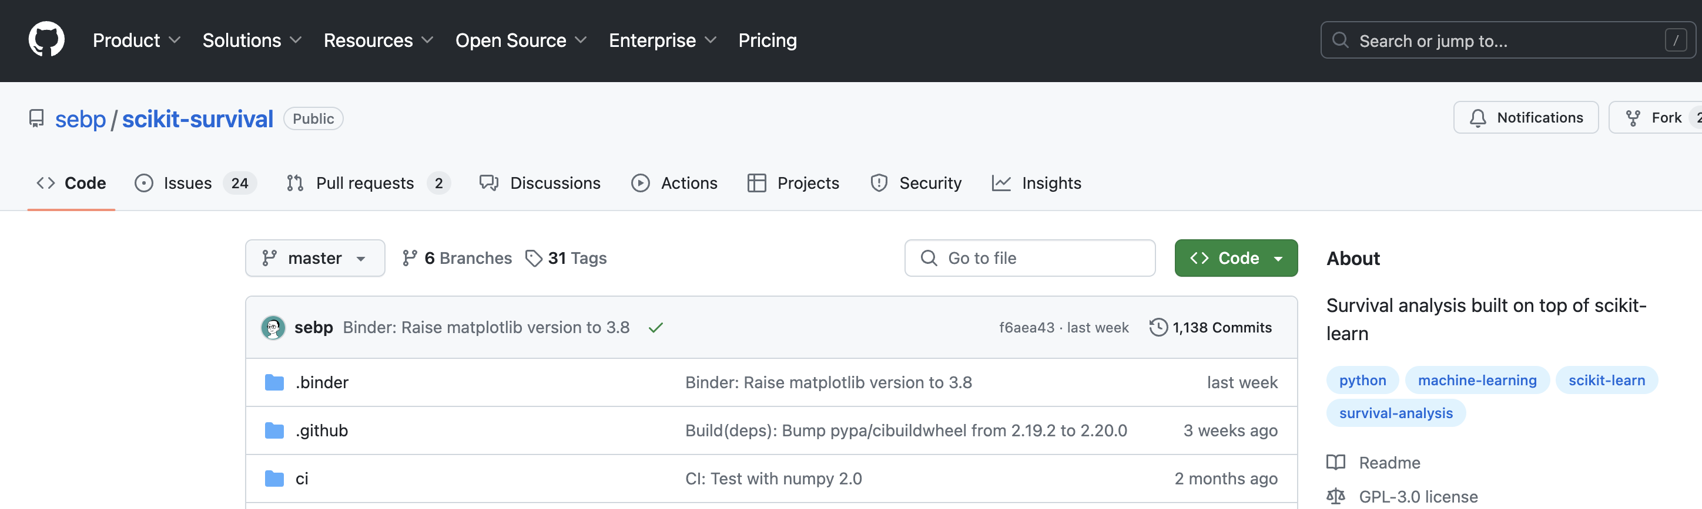
Notes:
Python lib that implements random survival forests

Slide 42
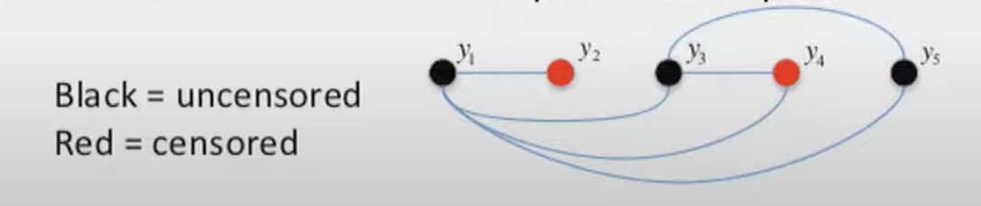
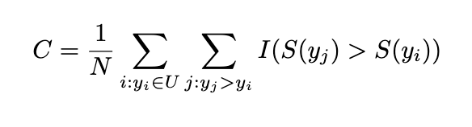
Evaluating a Survival Model
U: uncensored data points
I: indicator function
Notes:
Q: How would you?
This isn’t binary classification, ROC isn’t appropriate way to evaluate
Instead, we’ll use concordance or C-statistic. Let me motivate that here.
Q: DOES THIS LOOK FAMILIAR? (value of AUROC). Both: “Prob that given two randomly chosen instances (one positive and one negative), the model assigns a higher score to the positive instance. “

Slide 43
Today
Key probability distributions
Evaluation metrics
Survival modeling
Missing data

Slide 44

Predicting 30d Readmission
Dr. Nick, the CMIO at Springfield General Hospital, wants to build a model to predict, from EHR data for discharged patients, the probability of a 30d readmission.
However, the EHR data is very “holey.”
Notes:
Motivating example
In pset 2, you will work with some ‘holey’ healthcare data (MIMIC) and even quantify its ‘missingness’

Slide 45

Notes:
Which one is better? Why?
(Discarding leads to bias. Then again, so does imputation, just in different ways)
This is oversimplified – the real Q is HOW to impute.

Slide 46
Be Careful!
For example, standardized codes for smoking history or a family history of specific diseases exist but their underuse is well known.
https://www.jmir.org/2021/3/e22219/PDF
Notes:
Missing data comes in different flavors
So if we see a patient note and it says nothing about smoking, what can we conclude about the patient’s smoking status?

Slide 47
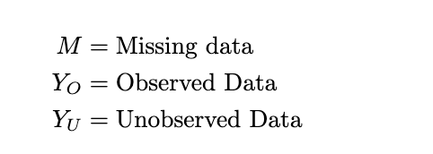
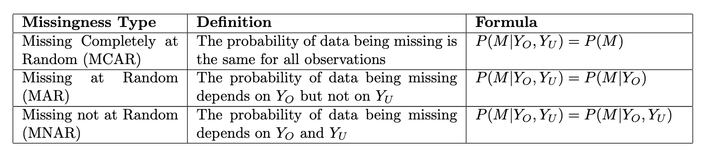
Flavors of Missing Data
https://www.sciencedirect.com/science/article/pii/S153204642200274X
Notes:
In general, we can classify missing data in 3 flavors
EXAMPLES:
MCAR: A lab sample is accidentally dropped, causing some measurements to be lost.
MAR: Older individuals are less likely to report their income, but this is fully explained by their age (which is observed).
MNAR: People with high incomes are less likely to report their income, regardless of other observed factors.

Slide 48
Pop Quiz: MCAR, MAR, MNAR?
We’re building a model to predict the likelihood of developing IBD, using EHR data for patients who visited the GI clinic in the last 12 months.
A patient's weight measurement is missing because the scale was out of order during their visit.
A patient's blood test results are missing because the samples were accidentally lost in transit to the lab.
Patients with a history of anxiety are more likely to have missing stress level data because they are less likely to complete the questionnaire.
Older patients are more likely to have missing colonoscopy results because they are less likely to undergo the procedure due to comorbidities.
Patients with heavy alcohol intake are less likely to report their alcohol consumption.
Notes:
MCAR - doesn’t depend on anything observed or unobserved
MCAR – doesn’t depend on anything observed or unobserved
MAR – depends on observed ‘anxiety’
MAR – depends on observed ‘age’
MNAR – depends on unobserved ’alcohol usage’

Slide 49

Simple Imputation
Only use for MCAR
Replace missing values with a single estimate
Mean imputation: Replace missing values with the mean of the observed values.
Median imputation: Replace missing values with the median of the observed values.
Mode imputation: Replace missing values with the most frequent value (mode) of the observed values.
Last observation carried forward (LOCF): Replace missing values with the last observed value for that variable.
Notes:
What’s the drawback?

Slide 50
Is Simple Imputation Appropriate?
Missing Bone mineral density (BMD) for an 80 year old female.
Missing BP data for patients who missed follow-up appointments.
Missing BMI data for patients admitted through the emergency department
Missing liver enzyme levels for patients who didn't complete all scheduled tests
Notes:
None of these - none are MCAR!

Slide 51
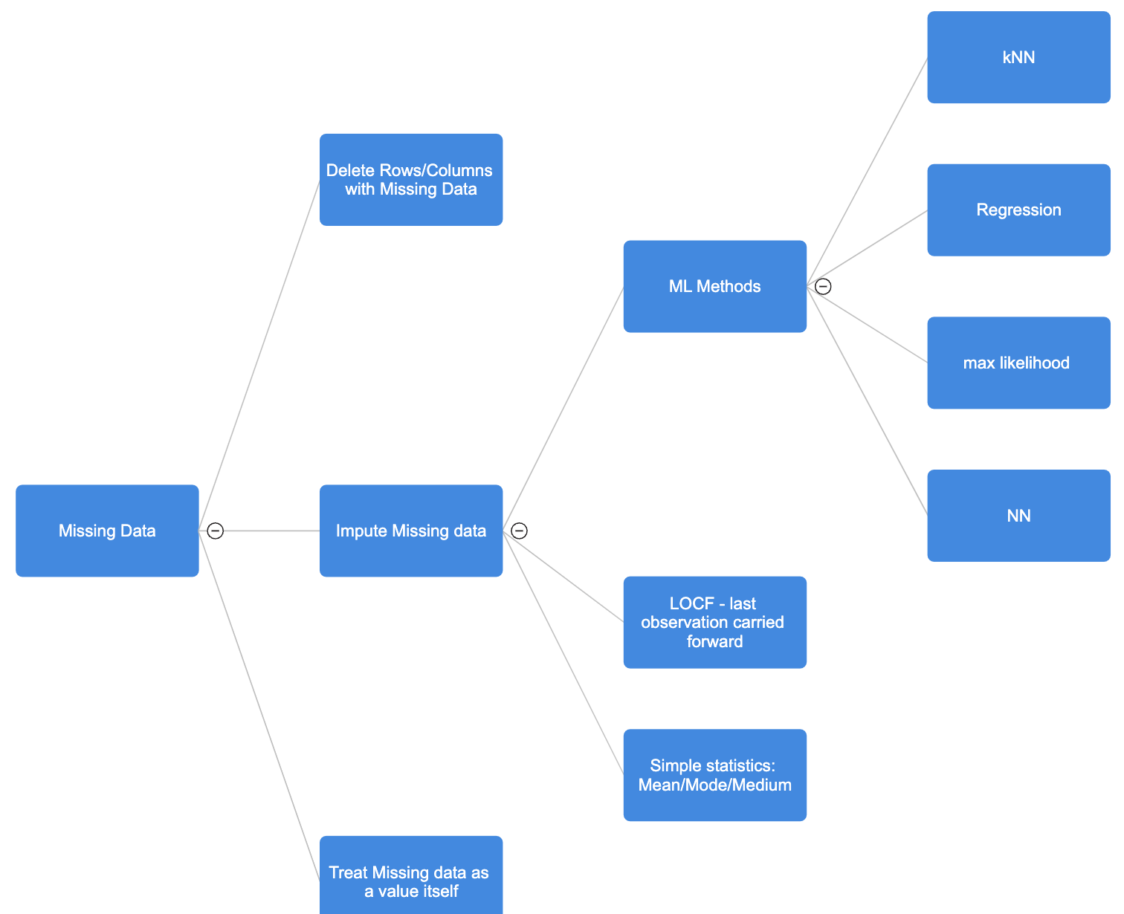
Dealing with Missingness

Slide 52
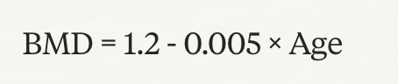
MAR: ML-Based Imputation
Example: Build a linear regression model for BMD against age, then use that to estimate missing BMD values.

Slide 53
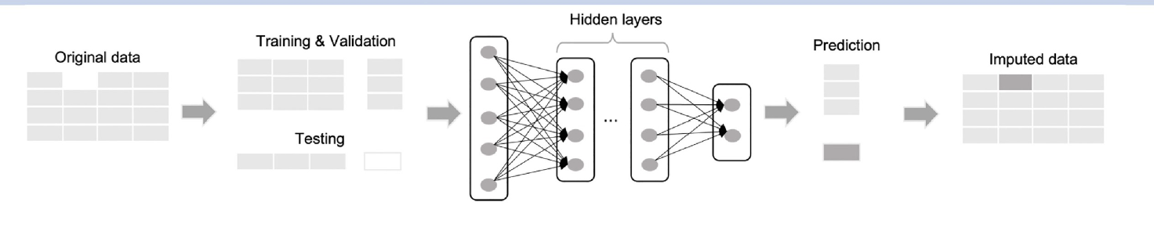
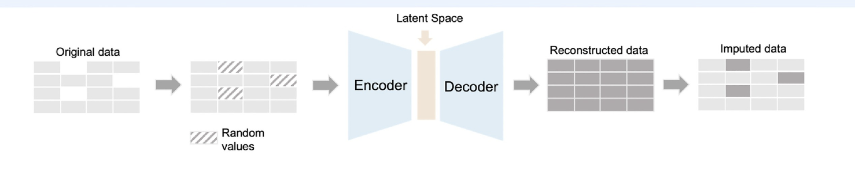
Imputation via Deep Learning
Multi-layer perceptron
Autoencoder
https://www.sciencedirect.com/science/article/pii/S093336572300101X
Notes:
2 approaches

Slide 54
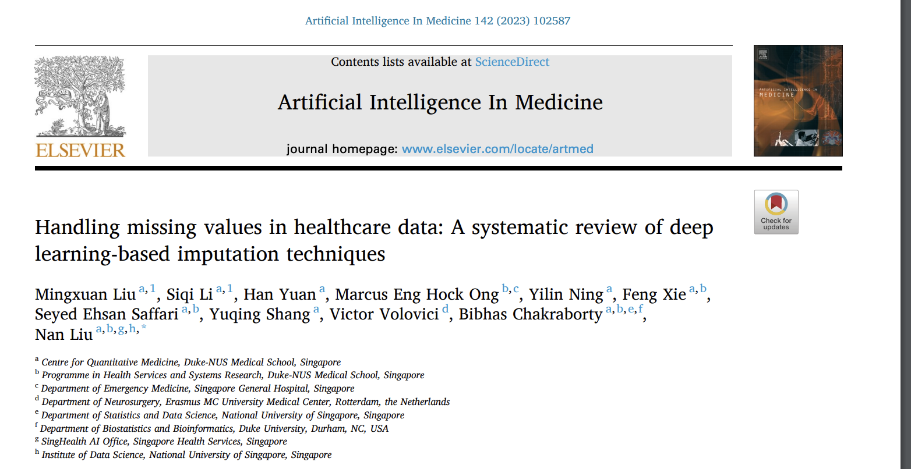
https://www.sciencedirect.com/science/article/pii/S093336572300101X

Slide 55
EOL

